Slide 1

Kalinga Institute of Industrial Technology
Ethereum
Crypto
Wallet
Subject – Computer Networks

Slide 2
GROUP-MEMBERS
AAKASH KUMAR GORAI - 21052042
RATINDRA KATYAYAN – 21052092
ABHIJEET KUMAR -21052044
HARSH JHA – 21052973
Undersigned by-
VISHAL MEENA SIR

Slide 3

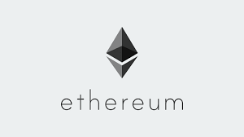
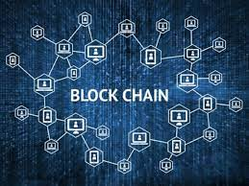
CONTENTS
Basics of Blockchain
Overview of the Project
Application of the Project
Why Project created using Blockchain

Slide 4

What is Blockchain?
Blockchain is a decentralized and distributed digital ledger that records transactions across multiple computers. It enables secure and transparent peer-to-peer transactions without the need for intermediaries.
Distributed Ledger
Cryptographic Security
Every participating computer holds a copy of the blockchain, ensuring transparency and immutability of recorded transactions.
Blockchain uses cryptographic techniques to secure transactions, making it nearly impossible to alter or tamper with the recorded data.

Slide 5
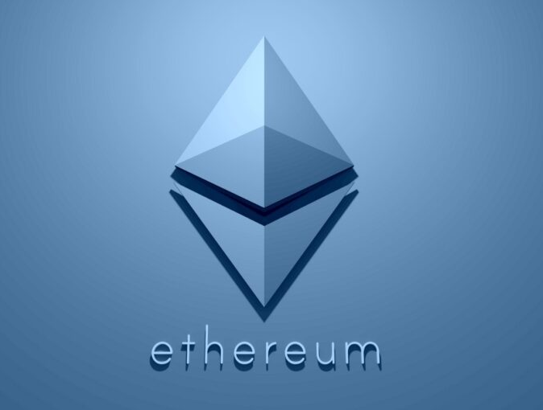
What is Ethereum then?
Ethereum is a decentralized open-source blockchain platform that enables the creation and execution of smart contracts. It was proposed by Vitalik Buterin in 2013 and went live in 2015. Ethereum's native cryptocurrency is called Ether (ETH), which is used to facilitate transactions and incentivize participants in the network.
At the heart of Ethereum's success lies its robust infrastructure and vibrant developer community. Together, they have propelled Ethereum to the forefront of the blockchain revolution, fueling the explosive growth of the initial coin offering (ICO) market.

Slide 6
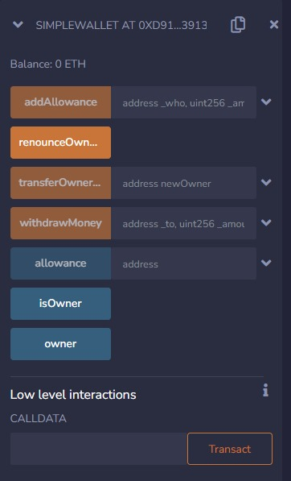
What our Project is about?
A decentralized app based on Ethereum blockchain which have multiple functions for crypto currency transactions. There will be feature of owner of the wallet who will have multiple privileges to add another user give privileges to other users. The owner can withdraw as well as deposit currency to the wallet. Other users can only deposit. We have deployed the application in Online Remix IDE and will test it using 100 local hosts test ethers.
Tech Stack Used : - Solidity, JavaScript, Web3.js, Openzeppelin

Slide 7
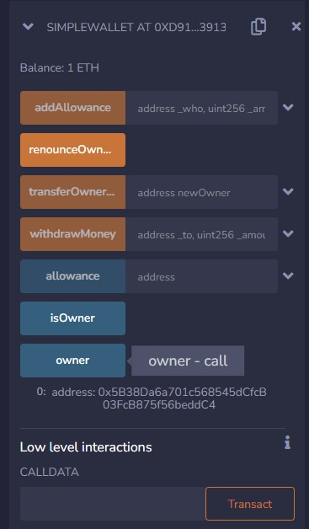
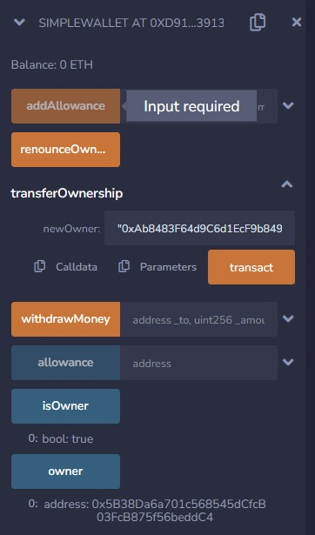
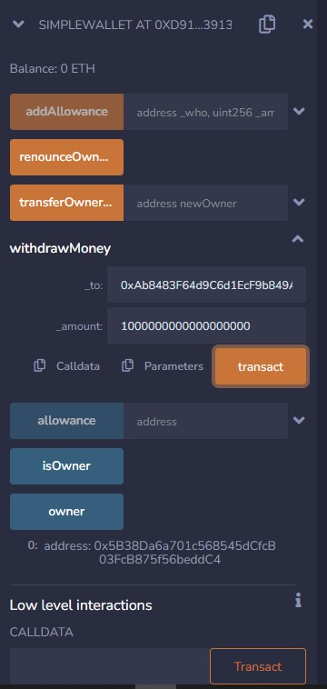
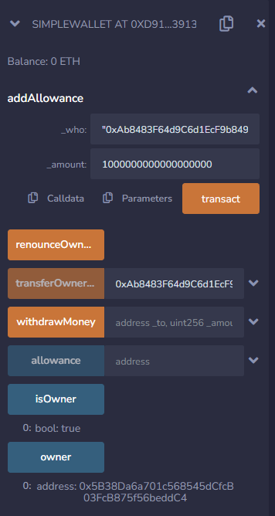
Functions and Features
Check Owner Address-
Transfer Ownership-
Transfer Money -
Add Allowances -
This function allows to transfer ownership.
This function allows to transfer currency to another address.
This function allows to add new addresses to with some allowances
This function shows the address of the owner.
Efficiency
Efficiency
Efficiency
Efficiency

Slide 8

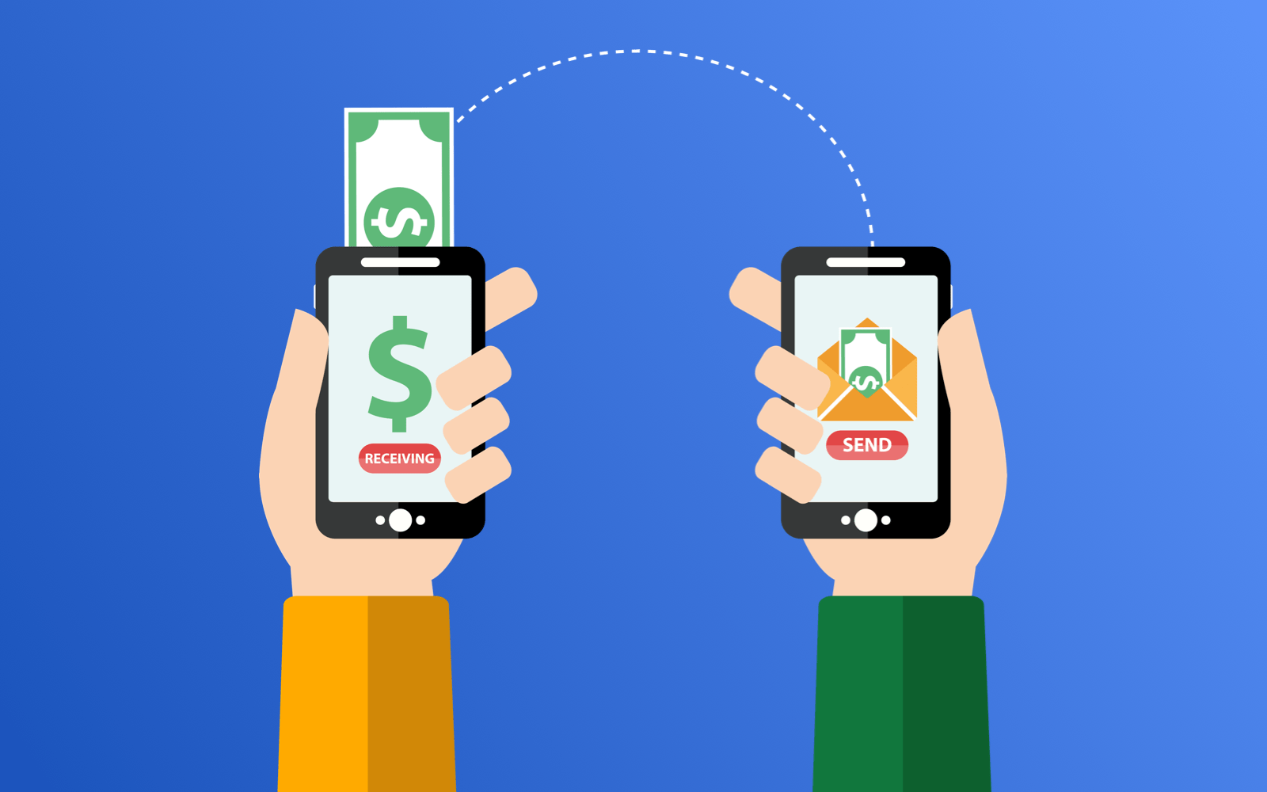
Applications of Crypto Wallet
1. Crowdfunding and Donations
Ethereum wallets are used in crowdfunding campaigns and charity donations. You can contribute to fundraising efforts, charitable causes, or support projects you believe in through your wallet.
2. Peer-to-Peer Payments
We can use Ethereum wallets to send money to friends or family. It's a way to settle debts or split expenses, whether it's for a dinner bill or sharing rent with roommates.

Slide 9
Applications of Crypto Wallet
3. Investment
Many individuals buy Ether as an investment, hoping its value will increase over time. Ethereum wallets are where you store and manage your investment in ETH.
2. Non-Fungible Tokens (NFTs)
We can use Ethereum wallets to buy, sell, and manage NFTs, which represent ownership of unique digital assets. NFTs are often used in the art, collectibles, and entertainment industries.

Slide 10
Why we used Ethereum Blockchain?
Transparency
Security
The use of cryptography and decentralization makes blockchain highly secure and resistant to hacking and fraud.
Blockchain provides a transparent and auditable record of transactions, increasing trust and accountability.
Efficiency
Decentralization
By removing intermediaries and automating processes, blockchain reduces costs and speeds up transactions.
No central authority or single point of failure, making it resilient and censorship-resistant.

Slide 11
Future of Blockchain
1
Mass Adoption
Blockchain technology is expected to revolutionize multiple industries, becoming an integral part of our daily lives.
2
Interoperability
Efforts are underway to establish standards that will allow different blockchain networks to seamlessly interact and share information.
3
Integration with AI and IoT
The combination of blockchain with artificial intelligence and the Internet of Things will enable new possibilities and disrupt various sectors.

Slide 12


